Slide 1
Reading files: Beyond the Basics
Databases to Dashboards
Lesson 4

Slide 2
Lesson Objectives
Read text and Excel files into R using tidyverse functions
Perform basic data cleansing functions after data import
Apply functional programming to iterate over multiple files

Slide 3
Typical Data Science Pipeline
From R for Data Science (https://r4ds.had.co.nz/introduction.html)
Notes:
We refer to R for Data Science, a free text available online frequently
Provide a nice model for the typical process of analyzing data to communicate
Focus for this hour is the machinery that allows us to capture this whole process in a way that is reproducible and also can communicate to others

Slide 4
Data import in the tidyverse
readr package
Rectangular delimited text file reading functions
Faster (~10x) than base R
Strings are preserved by default
Straightforward syntax

Slide 5
Readr syntax
import function
data object
imaginary_data_frame <- read_csv(file = "path/file_name.csv")
filename with path as a string
Notes:
imaginary_data_frame <- read_csv(
"imaginary_file.csv",
col_types = cols(
x = col_integer(),
y = col_character(),
z = col_datetime()
)
)

Slide 6
Readr syntax
imaginary_data_frame <- read_csv(file = "path/file_name.csv", col_types = cols( x = col_integer(),
y = col_character(), z = col_datetime() ))
specification of column types
Notes:
imaginary_data_frame <- read_csv(
"imaginary_file.csv",
col_types = cols(
x = col_integer(),
y = col_character(),
z = col_datetime()
)
)

Slide 7
Exercise 1
Use the read_csv() function to read the “2017-01-06_s.csv” file with your “data” folder into a data frame. The file is within the “data” folder so you will need to provide a path to that files that includes the folder.
What is the internal structure of the object? (Hint: use the str() function.)
Summarize the data.
Finally, let’s follow some best practices and explicitly define columns with the col_types argument. We want to explicitly define compound_name and sample_type as factors. Note that the col_factor() expects a definition of the factor levels but you can get around this by supplying a NULL. Then run a summary to review the data.

Slide 8
Dealing with excel files (gracefully)
readxl package
No external dependencies like xlsx package
Straightforward syntax
Can pull in specific worksheets or subsets of data

Slide 9
Readxl syntax
data object
import function
read_excel
read_xlxs
read_xls
excel_load <- read_excel(path = "path/file_name.xlxs")
filename with path as a string

Slide 10
Readxl syntax
excel_load <- read_excel(path = "path/file_name.xlxs",
sheet = "worksheet_name", range = "B1:D6")
specification of worksheet
specification of cell range

Slide 11
Readxl syntax
excel_load <- read_excel(path = "path/file_name.xlxs",
sheet = "worksheet_name", range = cell_cols("B:D"))
specification of worksheet
helper function to define columns
In multi-sheet file, reads in first worksheet by default

Slide 12
Readxl syntax
excel_load <- read_excel(path = "path/file_name.xlxs",
sheet = "worksheet_name", range = cell_rows(5:25))
specification of worksheet
helper function to define rows

Slide 13
Exercise 2
Use the excel_sheets()function to examine the "2017-01-06.xlsx" file
Use the read_excel()function to read this file into a data frame
View a summary of the imported data
Now read in only the first 5 columns of the samples worksheet using the worksheet and range arguments
Review the first 6 lines of the imported data

Slide 14
Cleaning dirty data with janitor
janitor package
clean_names() will reformat column names to conform to the tidyverse style guide: spaces are replaced with underscores & uppercase letters are converted to lowercase
empty rows and columns are removed with remove_empty_rows() or remove_empty_columns()
tabyl(variable) will tabulate into a data frame based on 1-3 variables supplied to it

Slide 15
Clean names example
library(janitor) readxl_load <- read_excel("data/2017-01-06.xlsx") readxl_load_cleaned <- readxl_load %>% clean_names() head(readxl_load_cleaned)

Slide 16
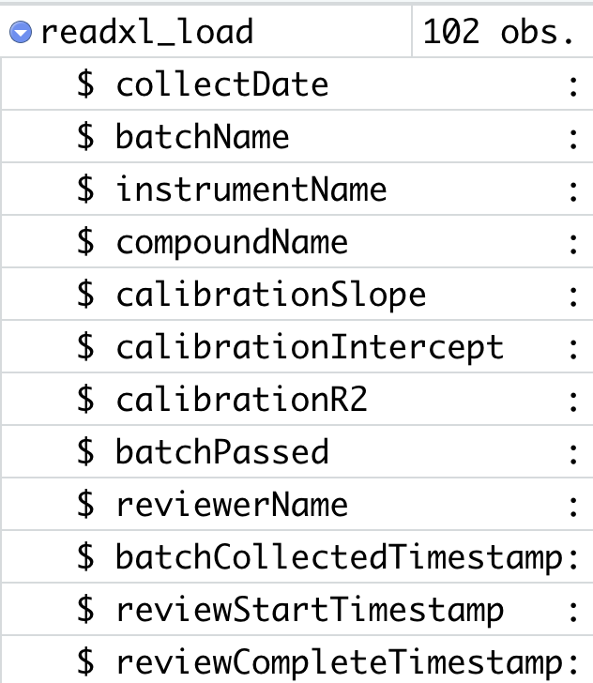
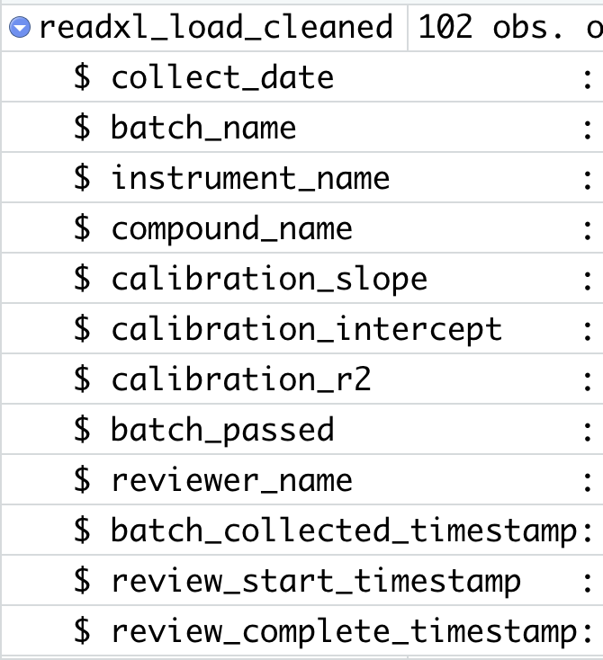
Clean names example

Slide 17
Why use iteration when reading files?
Scenario:
You have 12 months of data in 12 different files
You want to create a single data frame that includes the data
Files are named systematically and have the same structure & column names
Perfect scenario to iterate through a list

Slide 18
Purrr package and map functions
purrr package has a variety of map() functions
map() functions
take a vector as an input
apply a function to elements of the vector
return a vector of identical length to the input vector
selected based on type of output wanted

Slide 19
Map() syntax
map function
function to apply
map_dbl(df, mean)
vector input

Slide 20
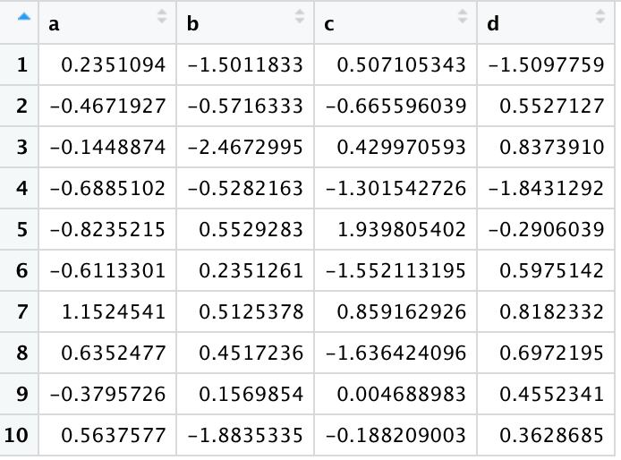
Map() example
vector, length = 4, numeric (double)
map_dbl(df, mean)
a | b | c | d
-0.0528 | -0.5043 | -0.1603 | 0.0678
df
mean(df$a) = -0.0528
mean(df$b) = -0.5043
mean(df$c) = -0.1603
mean(df$d) = 0.0678

Slide 21
Prerequisites to use map() to read files
The underlying file structure must be the same: for spreadsheet-like data, columns must be in the same positions in each with consistent data types
The files must have the same file extension
If there are multiple different file types (with different data structures) mixed in one directory, the files must organized and named in a way to associate like data sets with like

Slide 22
fs package and file operations
fs package
dir_ls() will return the names of files in a directory as a vector (works very nicely with map() functions)
create and delete files with file_create() and file_delete()
file_move()essentially moves files by renaming them
consistent function naming and syntax applies to paths, directories, files, and links

Slide 23
DIR_LS() Function will List files in a Directory
* = wildcard character, i.e. match any characters followed by “_s.csv” in this example
which directory
dir_ls("data", glob = "*_s.csv")
argument to match a pattern
match to sample files

Slide 24
Reading many data files into one data frame
Which map() function do we want?
Output = dataframe → map_dfr()
What vector input do we want? How can we get this?
Filenames for a specific type of file (e.g., _s) → dir_ls() using glob =
What function do we want to apply?
Read csv files → read_csv()

Slide 25
Reading many data files into one data frame
which directory
sample_file <-
dir_ls("data", glob = "*_s.csv") %>% map_dfr(read_csv) %>% clean_names()
map function
only want samples files
function to apply

Slide 26
Exercise 3
Use the dir_ls() function to read the filenames for the batches and the peaks types of files into vectors
Read each type of these files into a single dataframe using read_csv() and map_dfr()
Clean the column names
Review the structure of the new dataframes
Notes:
Now it is your turn to apply this same code for the batches and peaks file types to generate dataframes for those data.
1. Use the `dir_ls()` function to read the filenames for the batches and the peaks types of files into vectors
2. Read each type of these files into a single dataframe using `read_csv()` and `map_dfr()`
3. Clean the column names
4. Review the structure of the new dataframes

Slide 27
Word of warning
Don’t automate a broken process!
Always thoroughly vet your iteration code

Slide 28
Summary
readr functions such as read_csv() are faster than base R functions and do not automatically convert strings to factors
The readxl function read_excel() reads Excel files and offers functionality in specifying worksheets or subsets of the spreadsheet
The janitor package can help with cleaning up irregularly structured input files
The purrr package has useful tools for iterating that can be very powerful when coupled with file reading functions

Slide 29
Lesson Objectives
Read text and Excel files into R using tidyverse functions
Perform basic data cleansing functions after data import
Apply functional programming to iterate over multiple files

Slide 30



What Else? Other File Import Packages
vroom: reading files fast
haven: reading SAS, SPSS, Stata
googlesheets4: interface to Google Sheets

